Slide 1

Chapter 8
Internet Protocol
Objectives
Upon completion you will be able to:
Understand the format and fields of a datagram
Understand the need for fragmentation and the fields involved
Understand the options available in an IP datagram
Be able to perform a checksum calculation
Understand the components and interactions of an IP package

Slide 2
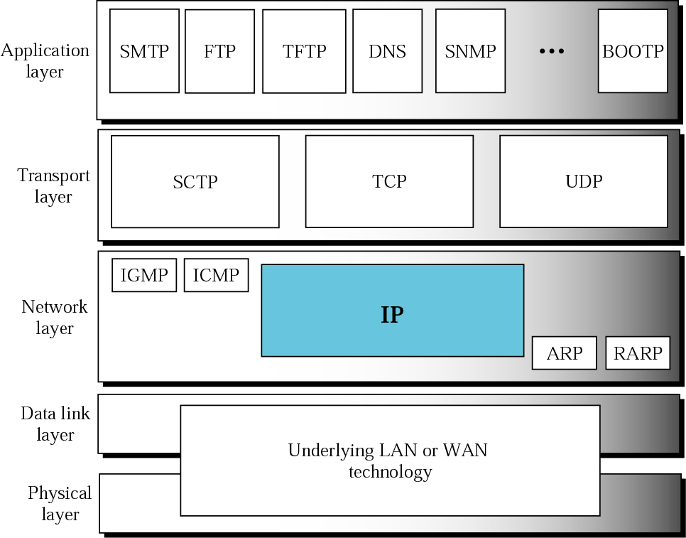
Figure 8.1 Position of IP in TCP/IP protocol suite

Slide 3
8.1 DATAGRAM
A packet in the IP layer is called a datagram, a variable-length packet consisting of two parts: header and data. The header is 20 to 60 bytes in length and contains information essential to routing and delivery.

Slide 4
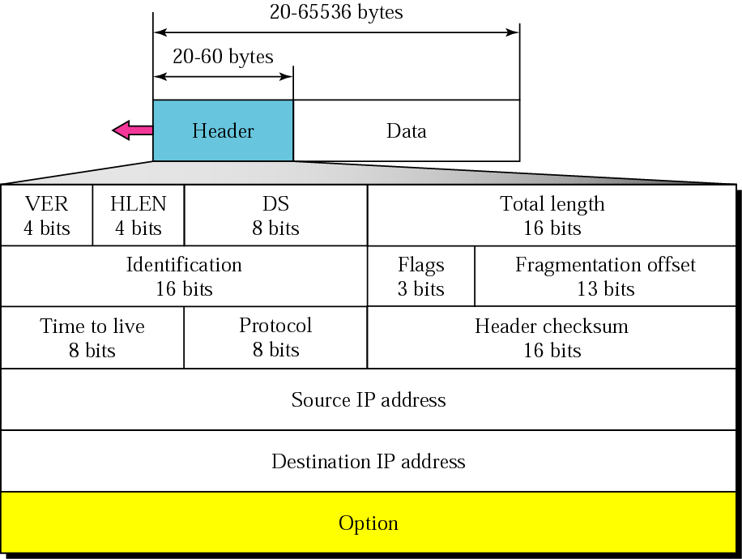
Figure 8.2 IP datagram

Slide 5
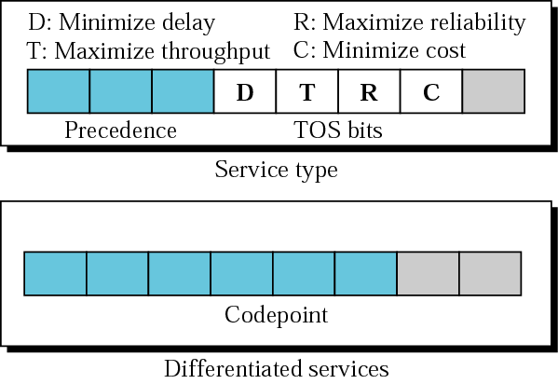
Figure 8.3 Service type or differentiated services

Slide 6

Note:
The precedence subfield was designed, but never used in version 4.

Slide 7
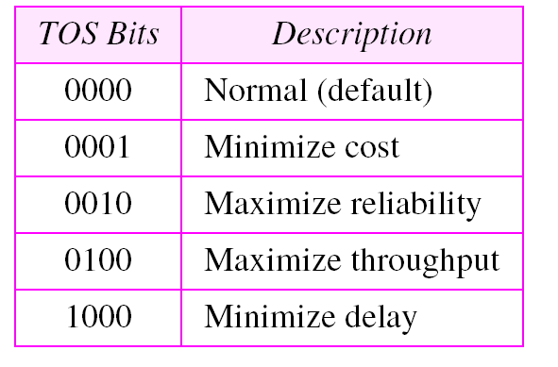
Table 8.1 Types of service

Slide 8
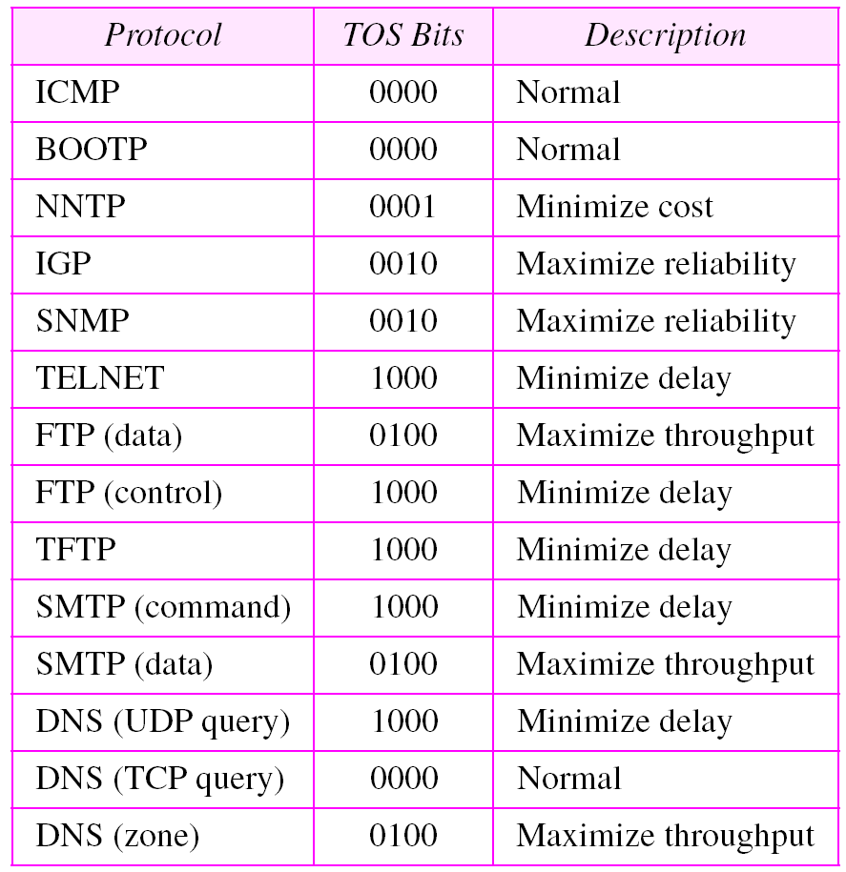
Table 8.2 Default types of service

Slide 9
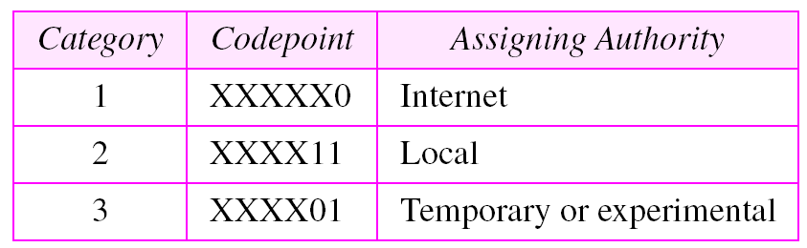
Table 8.3 Values for codepoints

Slide 10
Note:
The total length field defines the total length of the datagram including the header.

Slide 11
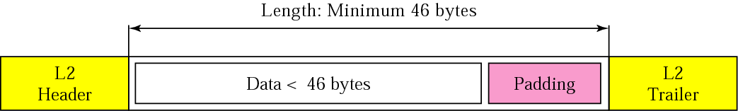
Figure 8.4 Encapsulation of a small datagram in an Ethernet frame

Slide 12
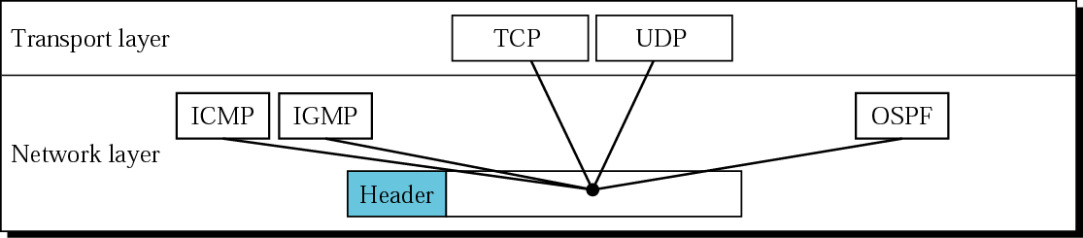
Figure 8.5 Multiplexing

Slide 13
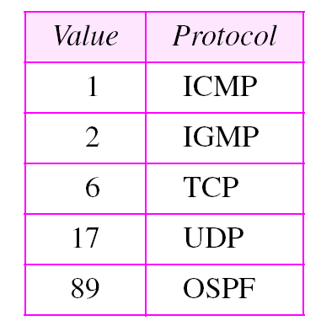
Table 8.4 Protocols

Slide 14
Example 1
An IP packet has arrived with the first 8 bits as shown:
01000010
The receiver discards the packet. Why?
Solution
There is an error in this packet. The 4 left-most bits (0100) show the version, which is correct. The next 4 bits (0010) show the header length; which means (2 × 4 = 8), which is wrong. The minimum number of bytes in the header must be 20. The packet has been corrupted in transmission.

Slide 15
Example 2
In an IP packet, the value of HLEN is 1000 in binary. How many bytes of options are being carried by this packet?
Solution
The HLEN value is 8, which means the total number of bytes in the header is 8 × 4 or 32 bytes. The first 20 bytes are the base header, the next 12 bytes are the options.

Slide 16
Example 3
In an IP packet, the value of HLEN is 5₁₆
and the value of the total length field is 0028₁₆ . How
many bytes of data are being carried by this packet?
Solution
The HLEN value is 5, which means the total number of bytes in the header is 5 × 4 or 20 bytes (no options). The total length is 40 bytes, which means the packet is carrying 20 bytes of data (40 − 20).

Slide 17
Example 4
An IP packet has arrived with the first few hexadecimal digits as shown below:
45000028000100000102 . . .
How many hops can this packet travel before being dropped? The data belong to what upper layer protocol?
Solution
To find the time-to-live field, we skip 8 bytes (16 hexadecimal digits). The time-to-live field is the ninth byte, which is 01. This means the packet can travel only one hop. The protocol field is the next byte (02), which means that the upper layer protocol is IGMP (see Table 8.4).

Slide 18
8.2 FRAGMENTATION
The format and size of a frame depend on the protocol used by the physical network. A datagram may have to be fragmented to fit the protocol regulations.
The topics discussed in this section include:
Maximum Transfer Unit (MTU)
Fields Related to Fragmentation

Slide 19
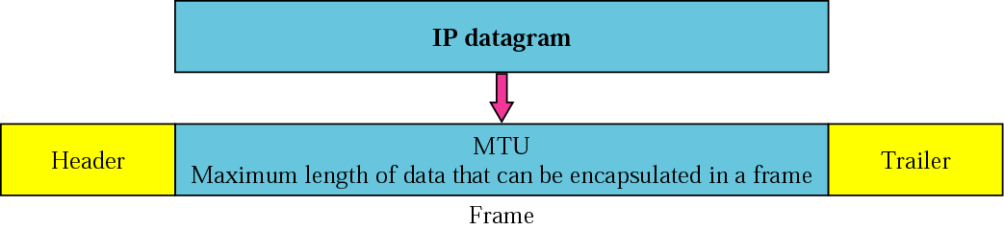
Figure 8.6 MTU

Slide 20
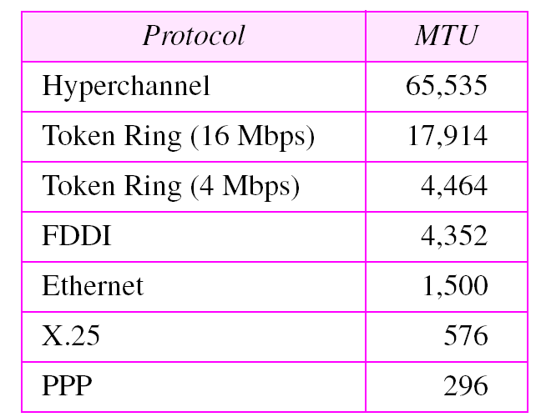
Table 8.5 MTUs for some networks

Slide 21
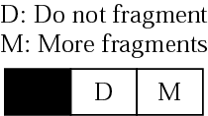
Figure 8.7 Flags field

Slide 22
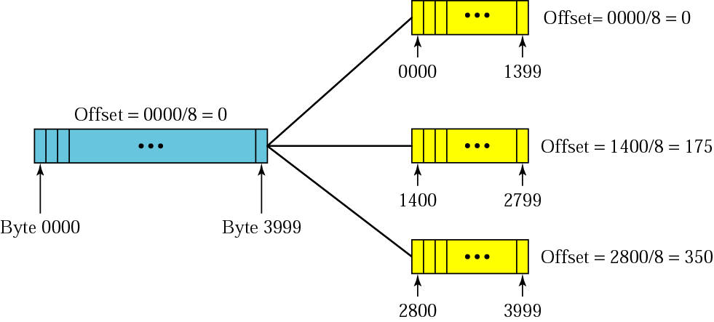
Figure 8.8 Fragmentation example

Slide 23
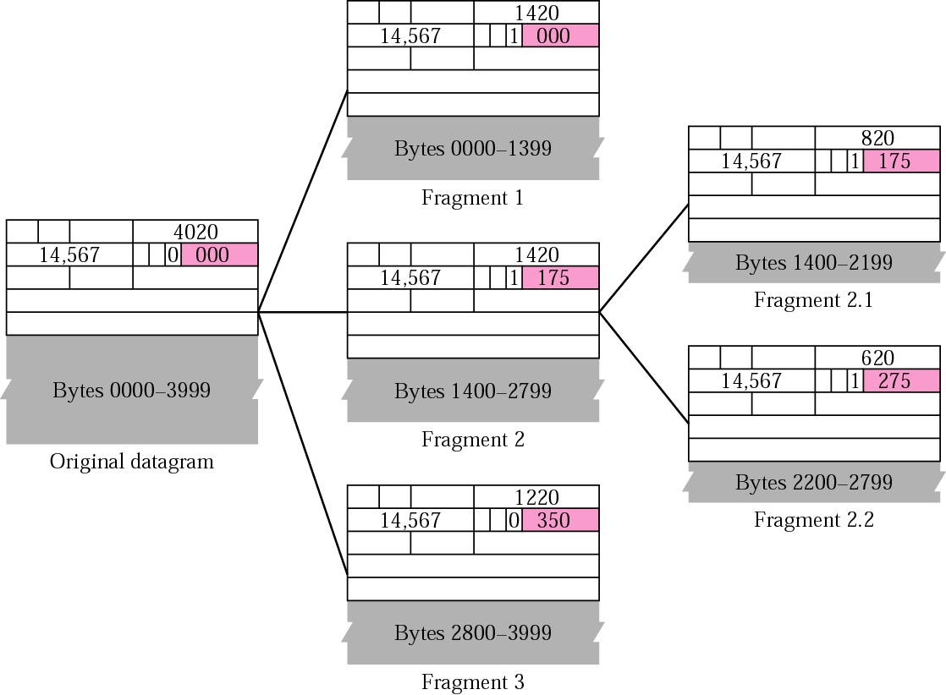
Figure 8.9 Detailed fragmentation example

Slide 24
Example 5
A packet has arrived with an M bit value of 0. Is this the first fragment, the last fragment, or a middle fragment? Do we know if the packet was fragmented?
Solution
If the M bit is 0, it means that there are no more fragments; the fragment is the last one. However, we cannot say if the original packet was fragmented or not. A nonfragmented packet is considered the last fragment.

Slide 25
Example 6
A packet has arrived with an M bit value of 1. Is this the first fragment, the last fragment, or a middle fragment? Do we know if the packet was fragmented?
Solution
If the M bit is 1, it means that there is at least one more fragment. This fragment can be the first one or a middle one, but not the last one. We don’t know if it is the first one or a middle one; we need more information (the value of the fragmentation offset). See also the next example.

Slide 26
Example 7
A packet has arrived with an M bit value of 1 and a fragmentation offset value of zero. Is this the first fragment, the last fragment, or a middle fragment?.
Solution
Because the M bit is 1, it is either the first fragment or a middle one. Because the offset value is 0, it is the first fragment.

Slide 27
Example 8
A packet has arrived in which the offset value is 100. What is the number of the first byte? Do we know the number of the last byte?
Solution
To find the number of the first byte, we multiply the offset value by 8. This means that the first byte number is 800. We cannot determine the number of the last byte unless we know the length of the data.

Slide 28
Example 9
A packet has arrived in which the offset value is 100, the value of HLEN is 5 and the value of the total length field is 100. What is the number of the first byte and the last byte?
Solution
The first byte number is 100 × 8 = 800. The total length is 100 bytes and the header length is 20 bytes (5 × 4), which means that there are 80 bytes in this datagram. If the first byte number is 800, the last byte number must be 879.

Slide 29
8.3 OPTIONS
The header of the IP datagram is made of two parts: a fixed part and a variable part. The variable part comprises the options that can be a maximum of 40 bytes.
The topics discussed in this section include:
Format
Option Types

Slide 30
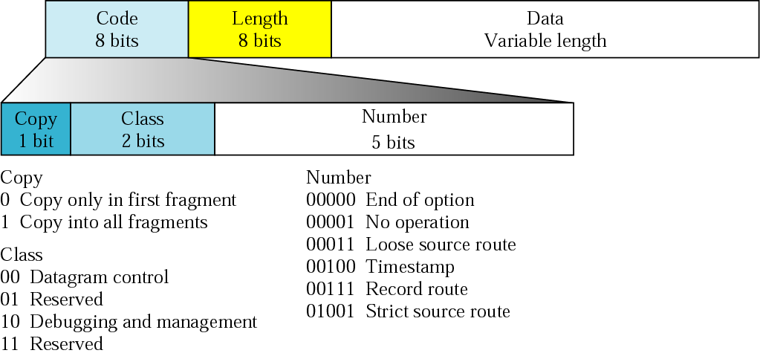
Figure 8.10 Option format

Slide 31
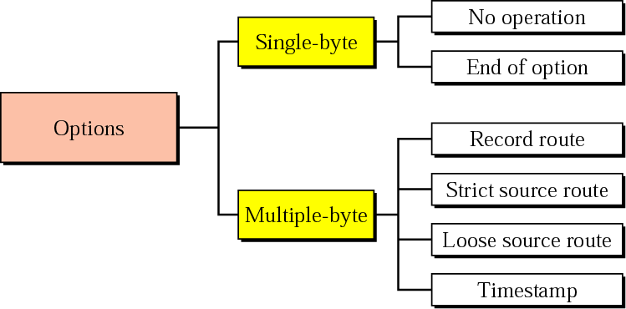
Figure 8.11 Categories of options

Slide 32
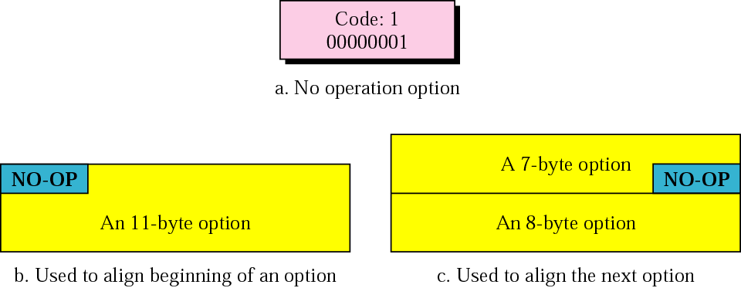
Figure 8.12 No operation option

Slide 33
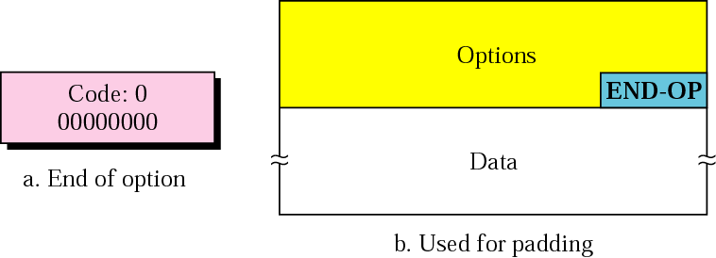
Figure 8.13 End of option option

Slide 34
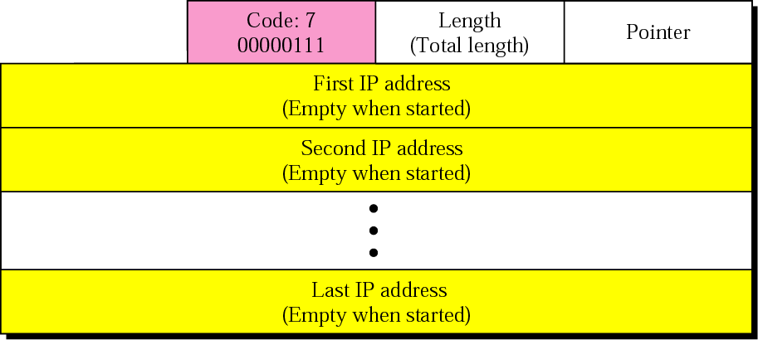
Figure 8.14 Record route option

Slide 35
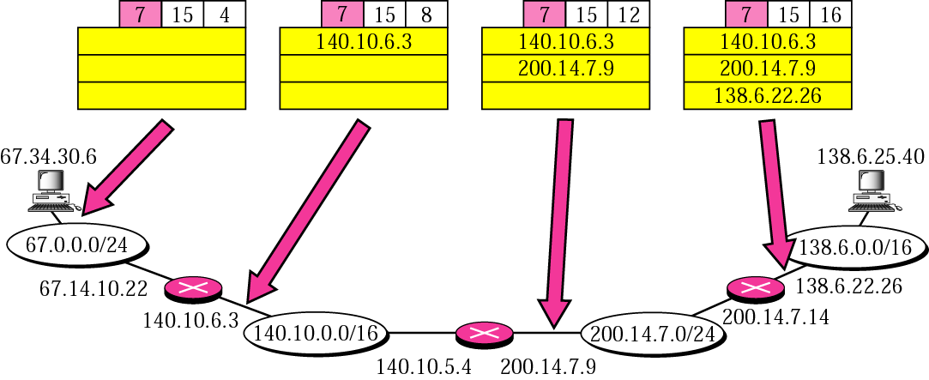
Figure 8.15 Record route concept

Slide 36
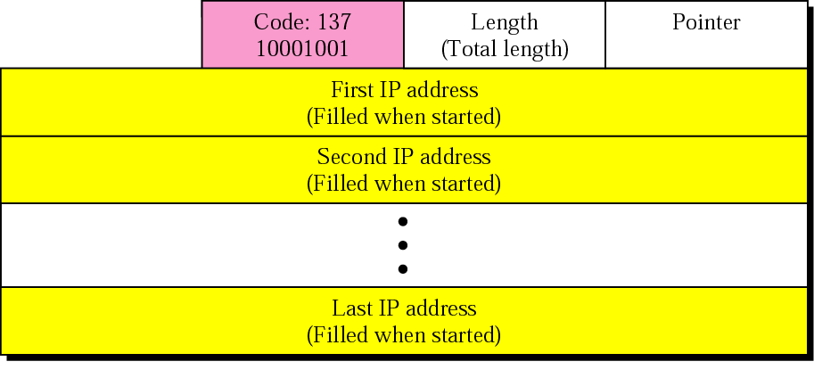
Figure 8.16 Strict source route option

Slide 37
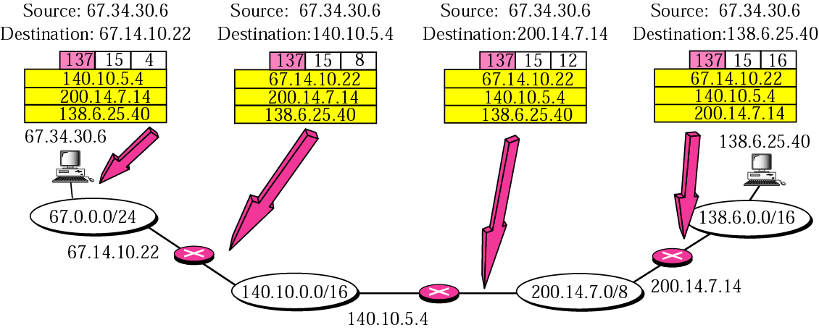
Figure 8.17 Strict source route concept

Slide 38
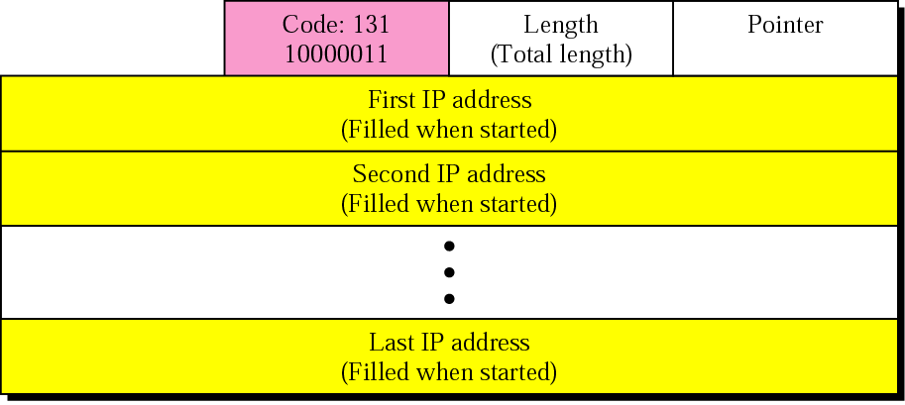
Figure 8.18 Loose source route option

Slide 39
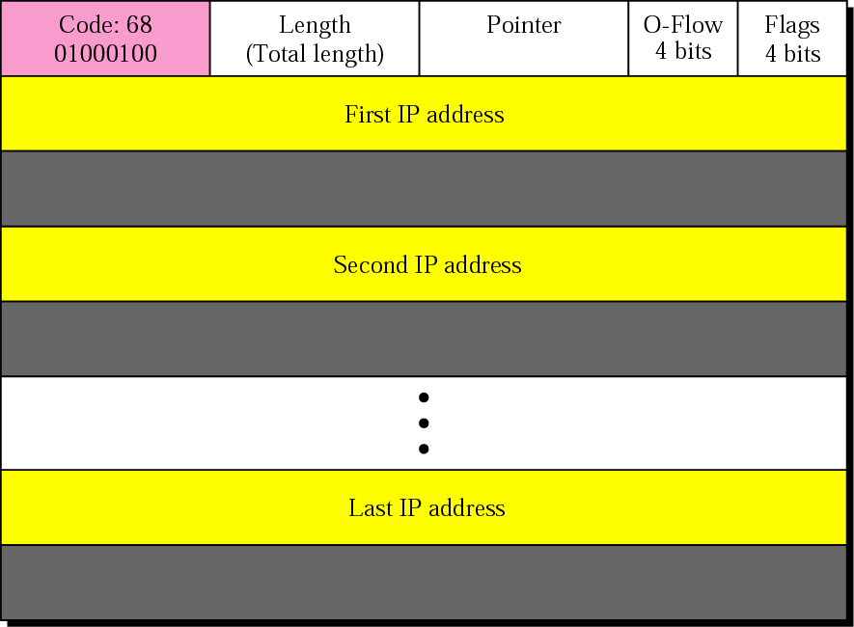
Figure 8.19 Timestamp option

Slide 40
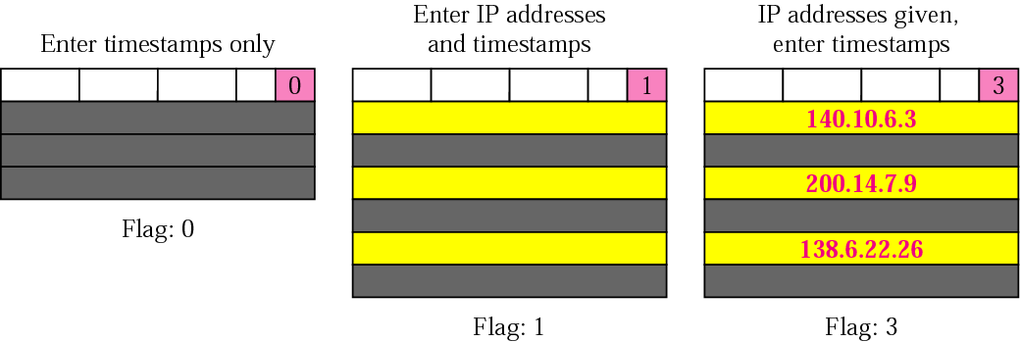
Figure 8.20 Use of flag in timestamp

Slide 41
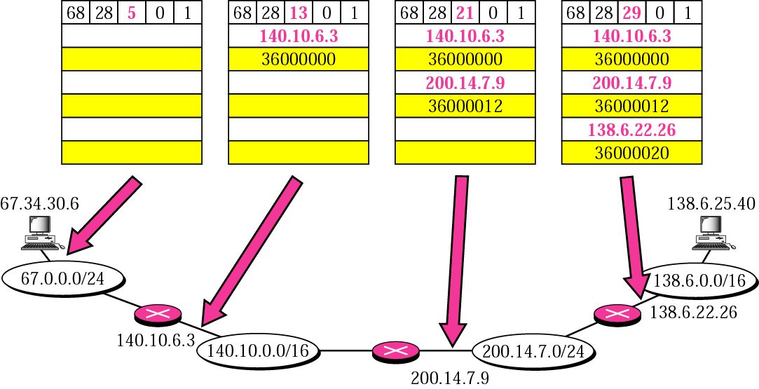
Figure 8.21 Timestamp concept

Slide 42
Example 10
Which of the six options must be copied to each fragment?
Solution
We look at the first (left-most) bit of the code for each option.
a. No operation: Code is 00000001; not copied.
b. End of option: Code is 00000000; not copied.
c. Record route: Code is 00000111; not copied.
d. Strict source route: Code is 10001001; copied.
e. Loose source route: Code is 10000011; copied.
f. Timestamp: Code is 01000100; not copied.

Slide 43
Example 11
Which of the six options are used for datagram control and which are used for debugging and management?
Solution
We look at the second and third (left-most) bits of the code.
a. No operation: Code is 00000001; datagram control.
b. End of option: Code is 00000000; datagram control.
c. Record route: Code is 00000111; datagram control.
d. Strict source route: Code is 10001001; datagram control.
e. Loose source route: Code is 10000011; datagram control.
f. Time stamp: Code is 01000100; debugging and management
control.

Slide 44
Example 12
One of the utilities available in UNIX to check the travelling of the IP packets is ping. In the next chapter, we talk about the ping program in more detail. In this example, we want to show how to use the program to see if a host is available. We ping a server at De Anza College named fhda.edu. The result shows that the IP address of the host is 153.18.8.1.
$ ping fhda.edu
PING fhda.edu (153.18.8.1) 56(84) bytes of data.
64 bytes from tiptoe.fhda.edu (153.18.8.1): ....
The result shows the IP address of the host and the number of bytes used.

Slide 45
Example 13
We can also use the ping utility with the -R option to implement the record route option.
$ ping -R fhda.edu
PING fhda.edu (153.18.8.1) 56(124) bytes of data.
64 bytes from tiptoe.fhda.edu (153.18.8.1): icmp_seq=0 ttl=62 time=2.70 ms
RR: voyager.deanza.fhda.edu (153.18.17.11)
Dcore_G0_3-69.fhda.edu (153.18.251.3)
Dbackup_V13.fhda.edu (153.18.191.249) tiptoe.fhda.edu (153.18.8.1)
Dbackup_V62.fhda.edu (153.18.251.34)
Dcore_G0_1-6.fhda.edu (153.18.31.254)
voyager.deanza.fhda.edu (153.18.17.11)
The result shows the interfaces and IP addresses.

Slide 46
Example 14
The traceroute utility can also be used to keep track of the route of a packet.
$ traceroute fhda.edu
traceroute to fhda.edu (153.18.8.1), 30 hops max, 38 byte packets
1 Dcore_G0_1-6.fhda.edu (153.18.31.254) 0.972 ms 0.902 ms 0.881 ms
2 Dbackup_V69.fhda.edu (153.18.251.4) 2.113 ms 1.996 ms 2.059 ms
3 tiptoe.fhda.edu (153.18.8.1) 1.791 ms 1.741 ms 1.751 ms
The result shows the three routers visited.

Slide 47
Example 15
The traceroute program can be used to implement loose source routing. The -g option allows us to define the routers to be visited, from the source to destination. The following shows how we can send a packet to the fhda.edu server with the requirement that the packet visit the router 153.18.251.4.
$ traceroute -g 153.18.251.4 fhda.edu.
traceroute to fhda.edu (153.18.8.1), 30 hops max, 46 byte packets
1 Dcore_G0_1-6.fhda.edu (153.18.31.254) 0.976 ms 0.906 ms 0.889 ms
2 Dbackup_V69.fhda.edu (153.18.251.4) 2.168 ms 2.148 ms 2.037 ms

Slide 48
Example 16
The traceroute program can also be used to implement strict source routing. The -G option forces the packet to visit the routers defined in the command line. The following shows how we can send a packet to the fhda.edu server and force the packet to visit only the router 153.18.251.4, not any other one.
$ traceroute -G 153.18.251.4 fhda.edu.
traceroute to fhda.edu (153.18.8.1), 30 hops max, 46 byte packets
1 Dbackup_V69.fhda.edu (153.18.251.4) 2.168 ms 2.148 ms 2.037 ms

Slide 49
8.4 CHECKSUM
The error detection method used by most TCP/IP protocols is called the checksum. The checksum protects against the corruption that may occur during the transmission of a packet. It is redundant information added to the packet.
The topics discussed in this section include:
Checksum Calculation at the Sender
Checksum Calculation at the Receiver
Checksum in the IP Packet

Slide 50
Note:
To create the checksum the sender does the following:
❏ The packet is divided into k sections, each of n bits.
❏ All sections are added together using 1’s complement
arithmetic.
❏ The final result is complemented to make the
checksum.

Slide 51
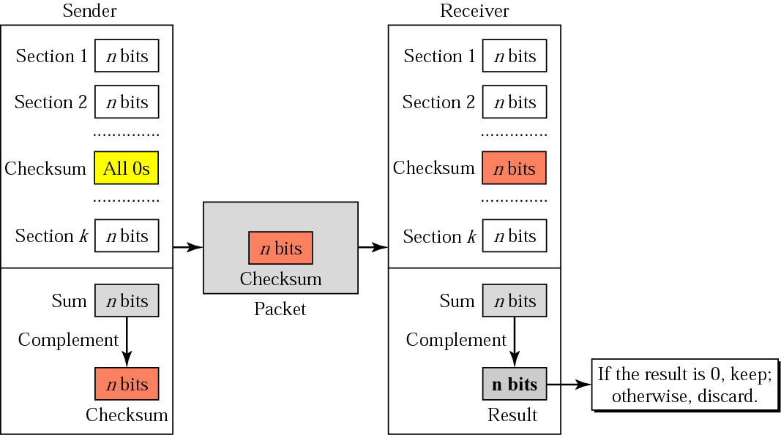
Figure 8.22 Checksum concept

Slide 52
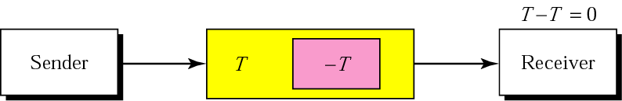
Figure 8.23 Checksum in one’s complement arithmetic

Slide 53
Example 17
Figure 8.24 shows an example of a checksum calculation for an IP header without options. The header is divided into 16-bit sections. All the sections are added and the sum is complemented. The result is inserted in the checksum field.
See Next Slide

Slide 54
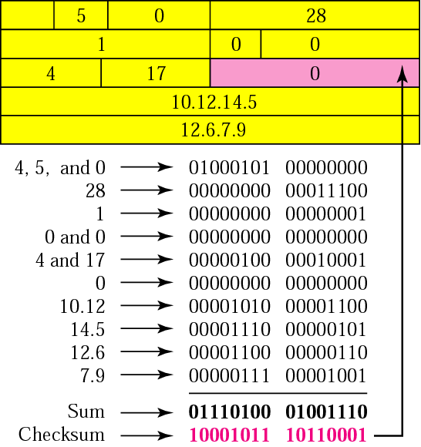
Figure 8.24 Example of checksum calculation in binary

Slide 55
Example 18
Let us do the same example in hexadecimal. Each row has four hexadecimal digits. We calculate the sum first. Note that if an addition results in more than one hexadecimal digit, the right-most digit becomes the current-column digit and the rest are carried to other columns. From the sum, we make the checksum by complementing the sum. However, note that we subtract each digit from 15 in hexadecimal arithmetic (just as we subtract from 1 in binary arithmetic). This means the complement of E (14) is 1 and the complement of 4 is B (11). Figure 8.25 shows the calculation. Note that the result (8BB1) is exactly the same as in Example 17.
See Next Slide

Slide 56
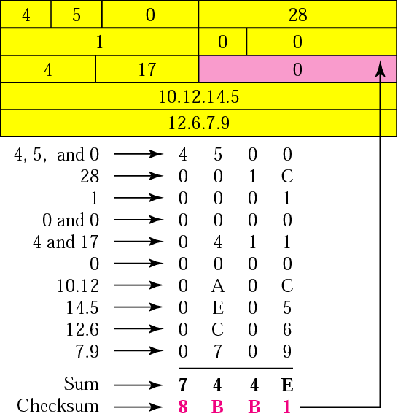
Figure 8.25 Example of checksum calculation in hexadecimal

Slide 57
Note:
Check Appendix C for a detailed description of checksum calculation and the handling of carries.

Slide 58
8.5 IP PACKAGE
We give an example of a simplified IP software package to show its components and the relationships between the components. This IP package involves eight modules.
The topics discussed in this section include:
Header-Adding Module
Processing Module
Queues
Routing Table
Forwarding Module
MTU Table
Fragmentation Module
Reassembly Table
Reassembly Module

Slide 59
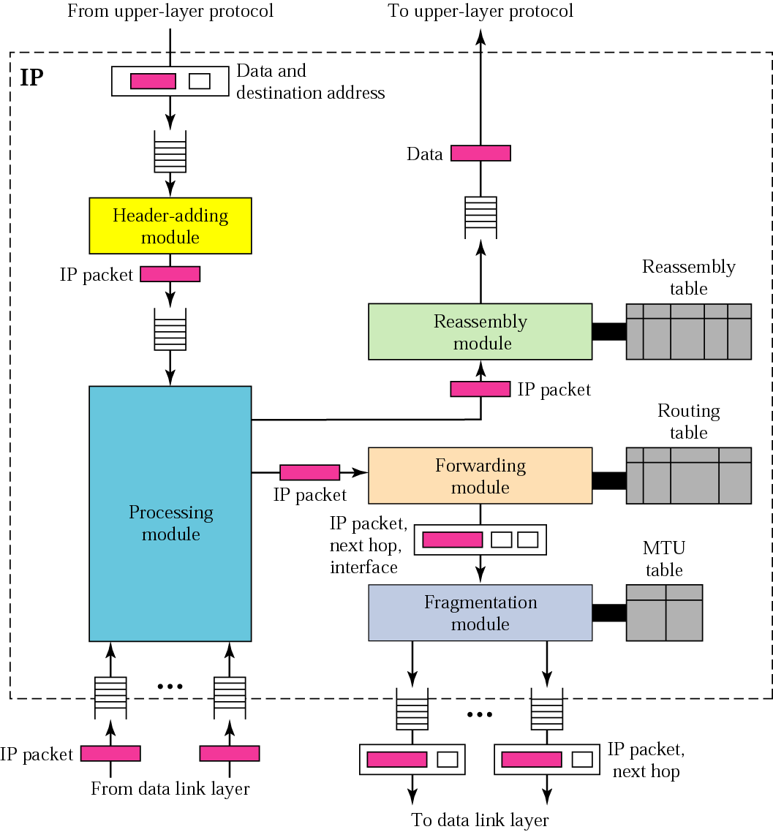
Figure 8.26 IP components

Slide 60
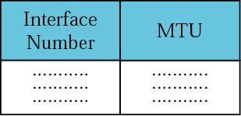
Figure 8.27 MTU table

Slide 61
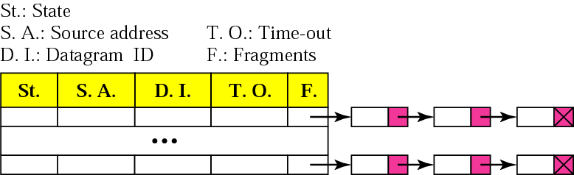
Figure 8.28 Reassembly table

